Slide 1
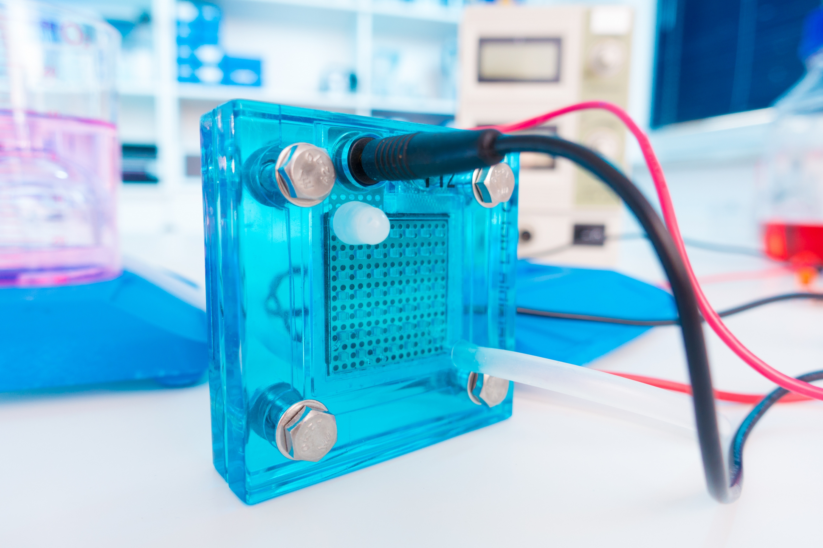


SPLITTING
WATER
Lesson 2

Slide 2





EDUCATIONAL OBJECTIVES
Upon completion of this lesson students, using the fuel cell (electrolyzer) in the DIY kit, will be able to:
IDENTIFY
hydrogen and oxygen
as the molecules detach from each other using distilled water.
MEASURE
ANALYZE
the ratio of oxygen to hydrogen in water.
hydrogen's effectiveness as an energy source.

Slide 3
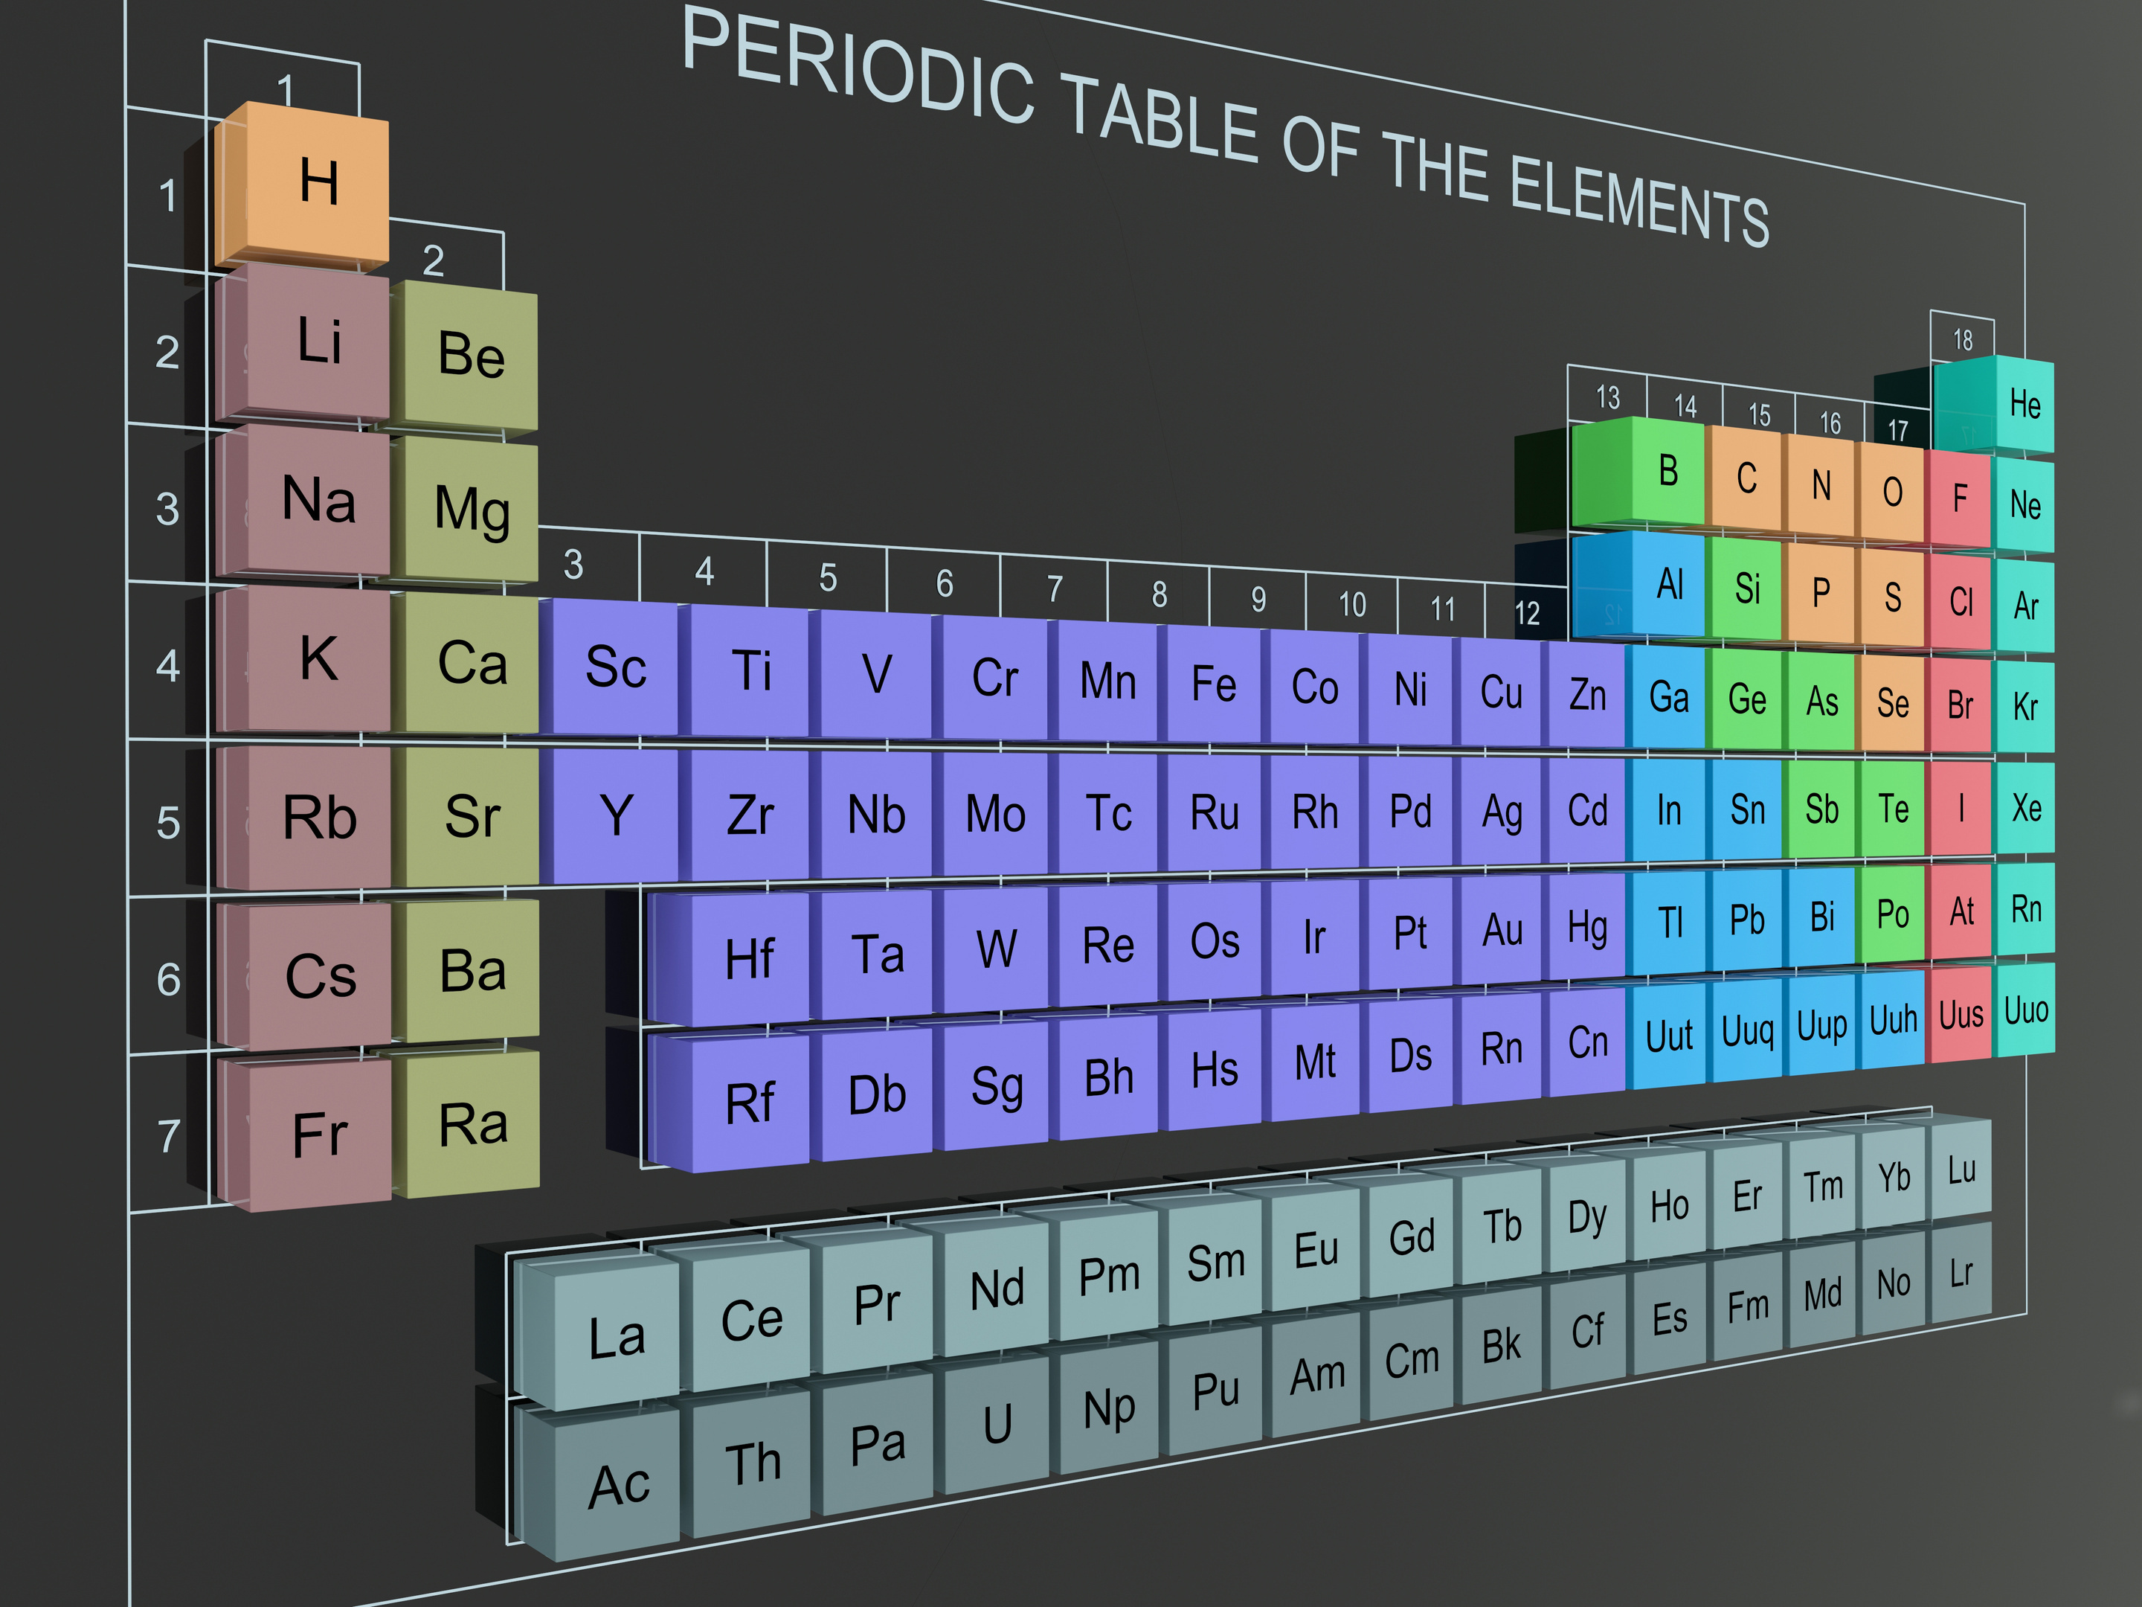

Slide 4


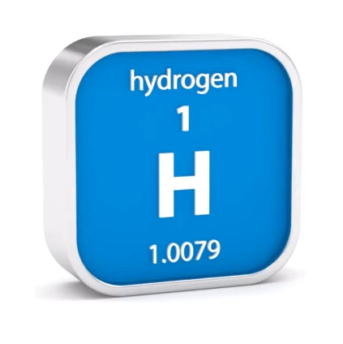

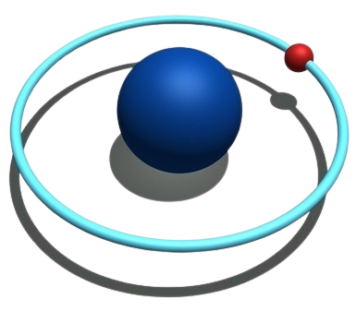
what is HYDROGEN
Hydrogen is the first element of the periodic table due to its atomic number of one.
Hydrogen is also the most abundant element in the universe, making up about 70% of all atoms.
However not much of it is used for energy.

Slide 5
who uses HYDROGEN

Slide 6
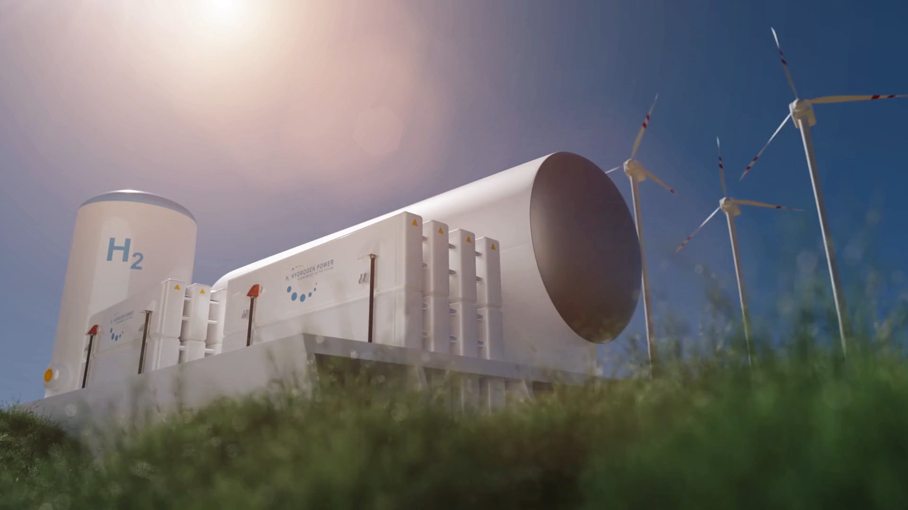
Hydrogen is used by many industries daily, in both its liquid and gas forms. This includes the petroleum industry as well as in various manufacturing processes for producing chemicals, foods, and electronics.

Slide 7


Hydrogen was used as a fuel for the NASA space shuttle (Hydrogen Basics: Air products)

Slide 8

On Earth hydrogen is mostly found in water.

Slide 9

Hydrogen is abundant in the Sun, the stars,
and even the planet Jupiter.

Slide 10
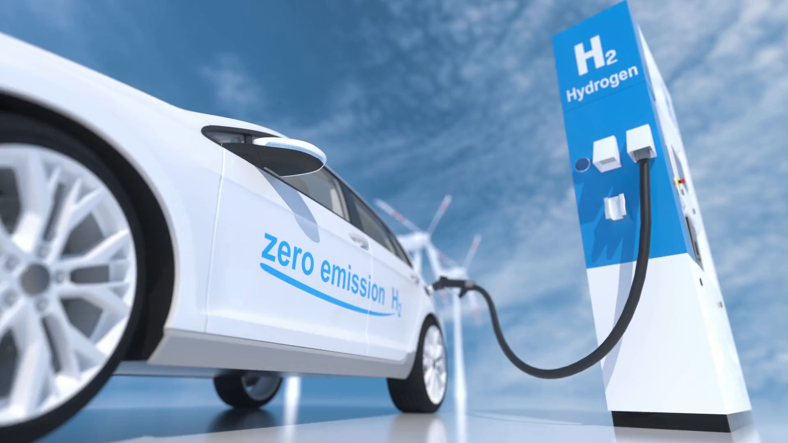
Because hydrogen is a clean energy source, transportation industries have been using it more frequently. Why not use an element that can be found in water since water covers about 71% of the Earth surface?

Slide 11







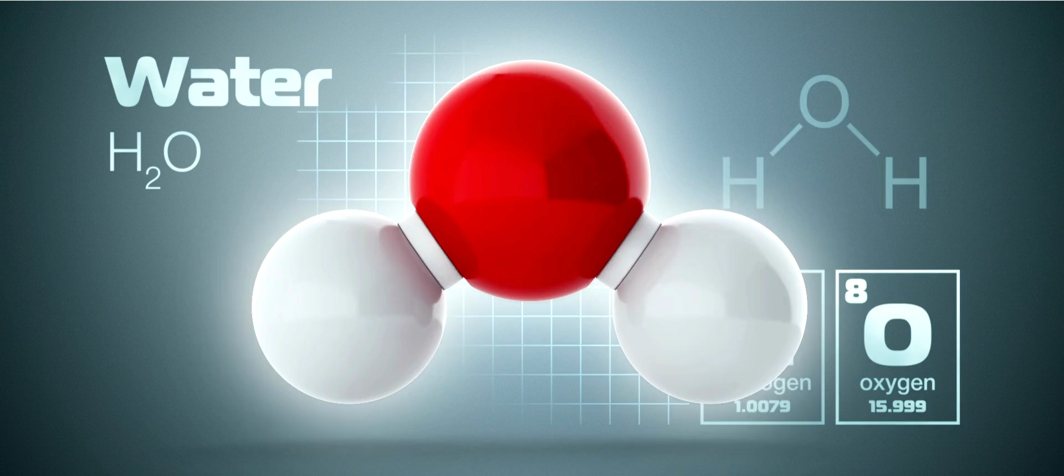



how is HYDROGEN generated
FUEL CELL
ELECTRIC CURRENT
Electrolysis refers to the process of breaking the bonds between hydrogen and oxygen molecules in water using electricity.
e
-
FUEL IN
AIR IN
e
-
e
-
H
+
-
H
2
O
e
H
2
O
2
H
+
UNUSED
GASES OUT
EXCESS
FUEL
H
2
O
ANODE
CATHODE
ELECTROLYTE

Slide 12

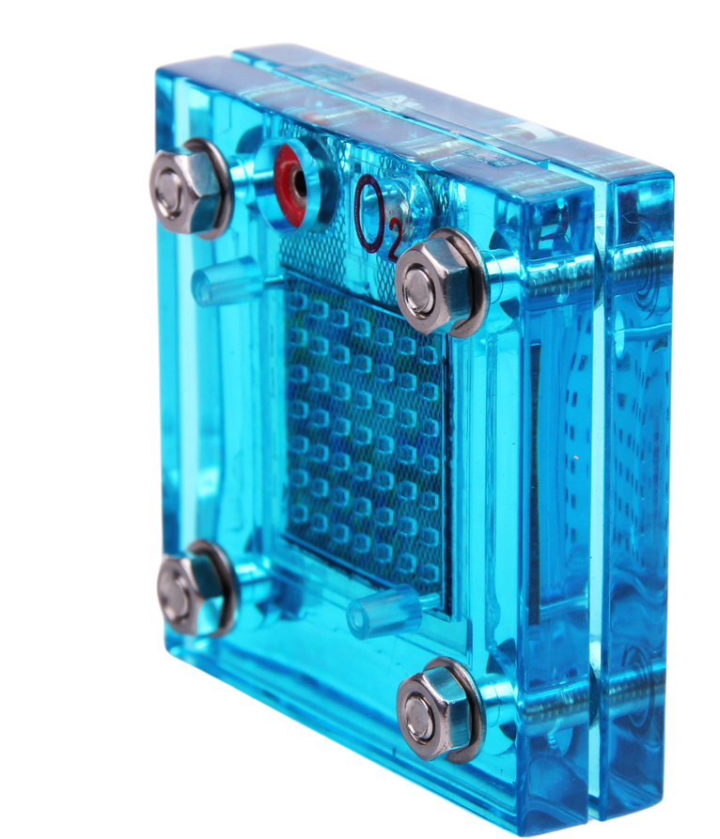
NOW
IT‘S YOUR TURN
HOW TO GENERATE HYDROGEN USING THE ELECTROLYZER

Slide 13
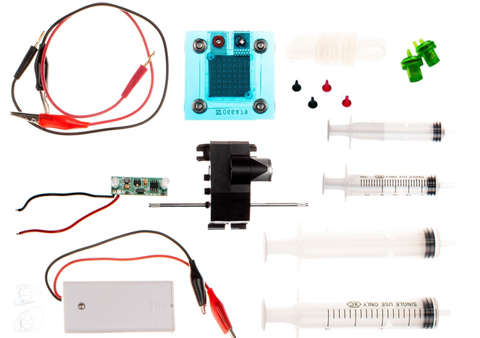
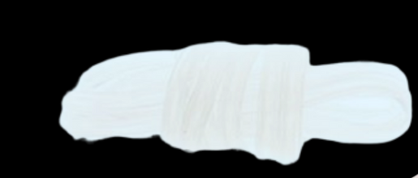
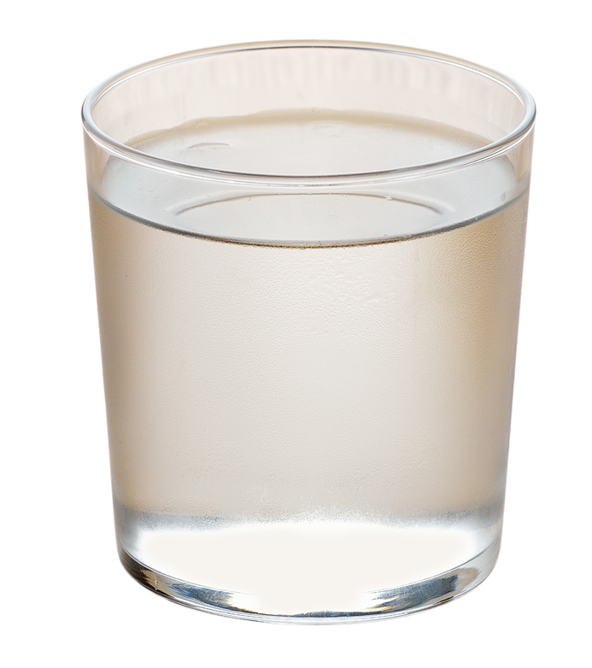
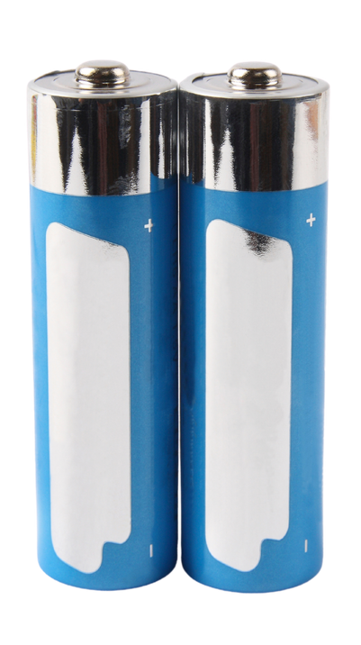
Leads
Pressure relief
valve
Alligator
clips
Battery
box
Fuel Cell/Electrolyzer
Distilled/Deionised water
Tubing
AA
Batteries
Syringes
MATERIALS

Slide 14


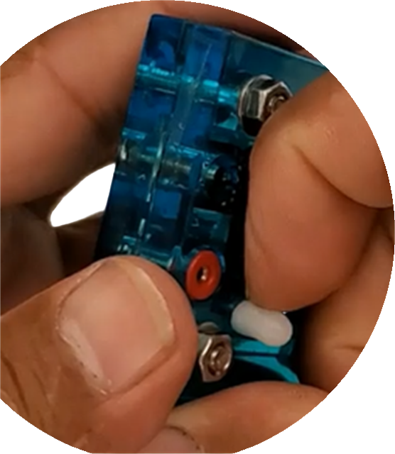

Remove covering on fitting.

Slide 15
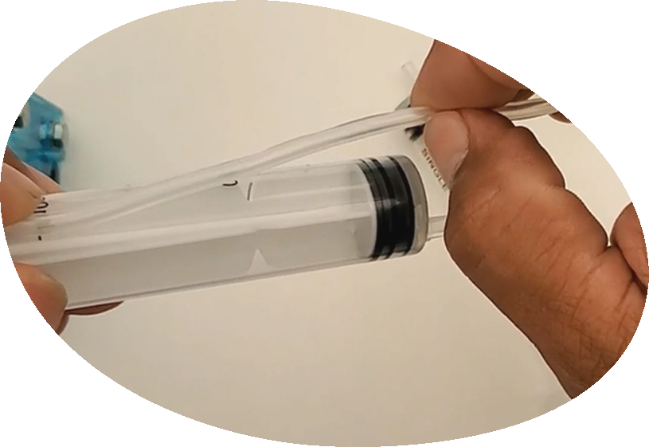
Cut 4 pieces
of tubing about
4 inches long.
Use the length of the syringe to mesure.

Slide 16
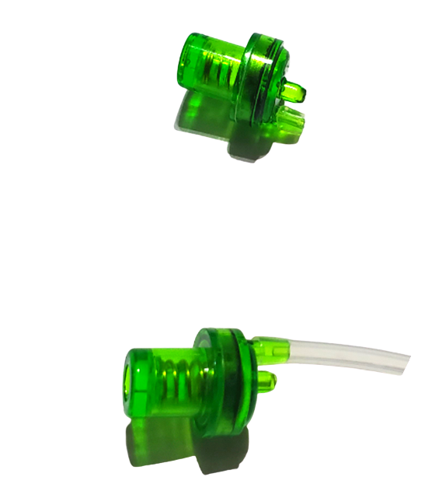


Connect one piece of tubing to each release valve.
Connect to exterior fitting
(never to the middle).

Slide 17
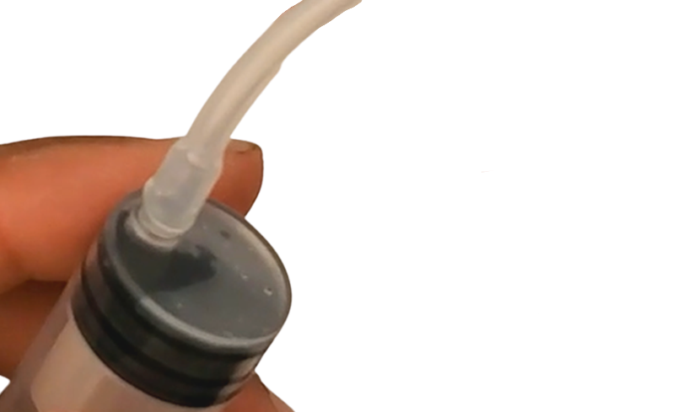
Connect the remaining pieces
of tubing to the syringes.

Slide 18
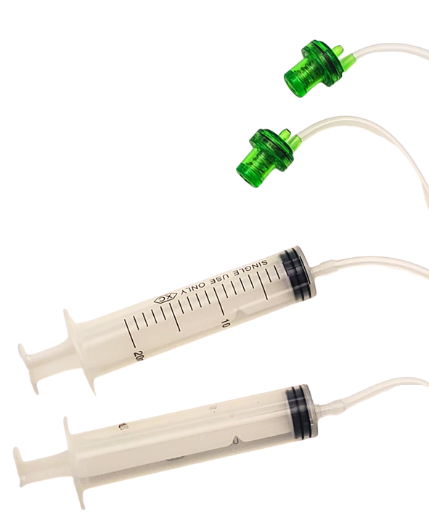

ALL CONNECTED

Slide 19
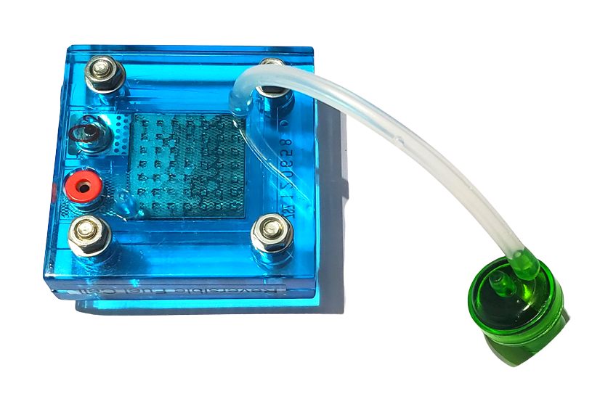
Connect the otherside of
the tubing from release valve
to the fuel cell.

Slide 20
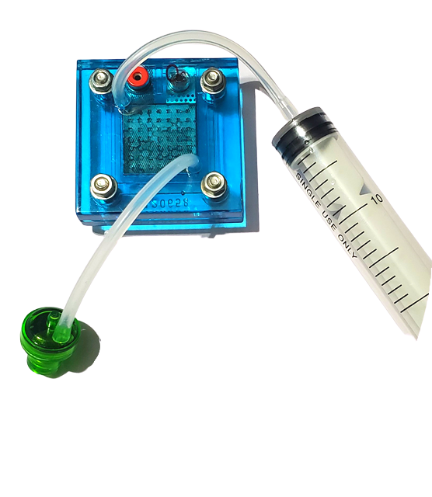
Connect the other side
of the tubing from syringe
to fuel cell.

Slide 21
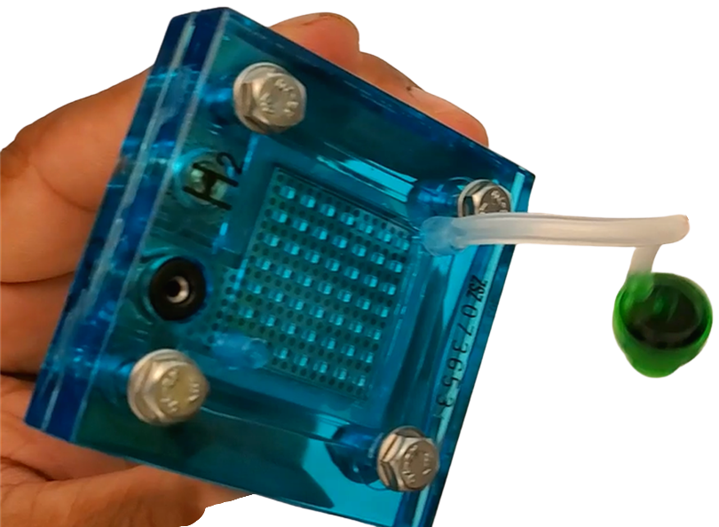
Repeat the process
on the other side.

Slide 22
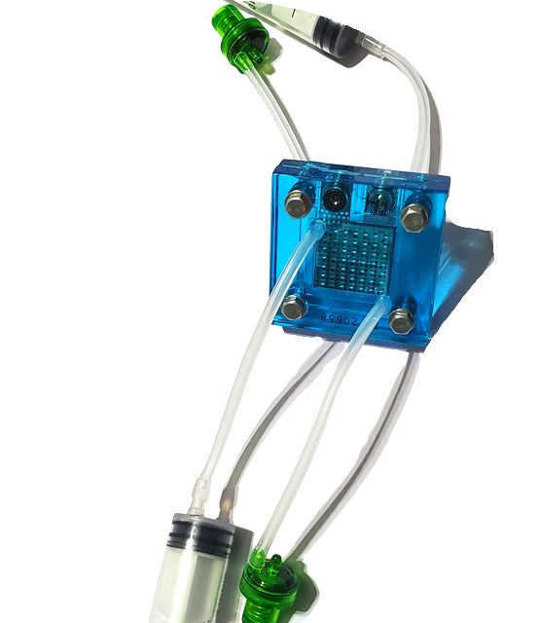
ALL TUBING CONNECTED TO FUEL CELL

Slide 23
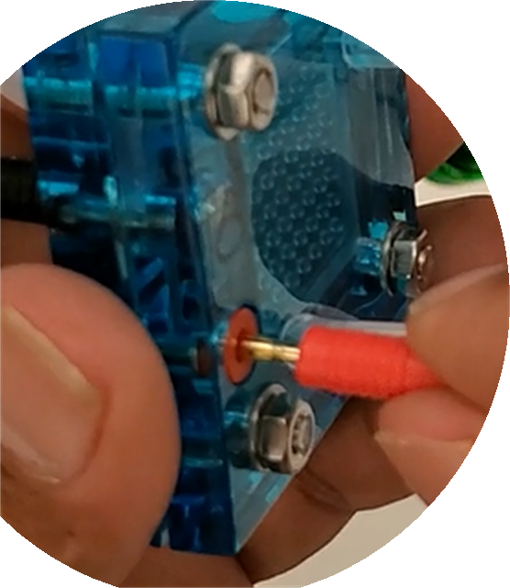
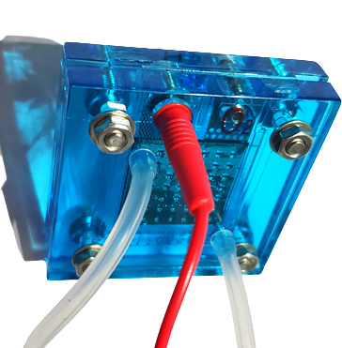
Plug in the red lead
into the red port on fuel cell.

Slide 24
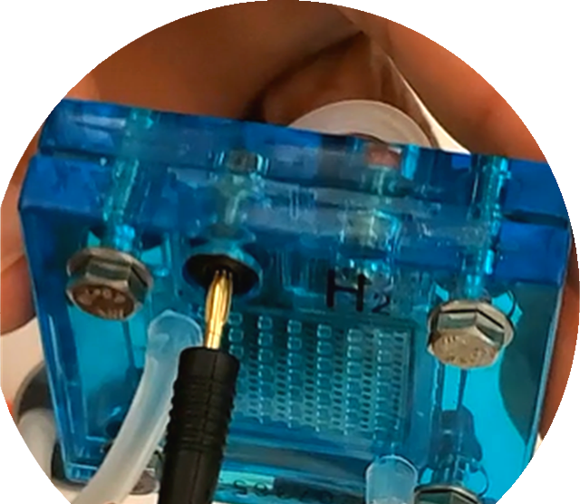
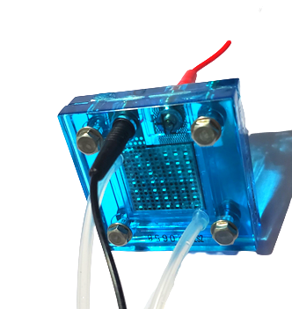
Plug the black lead
into the black port on the fuel cell.

Slide 25
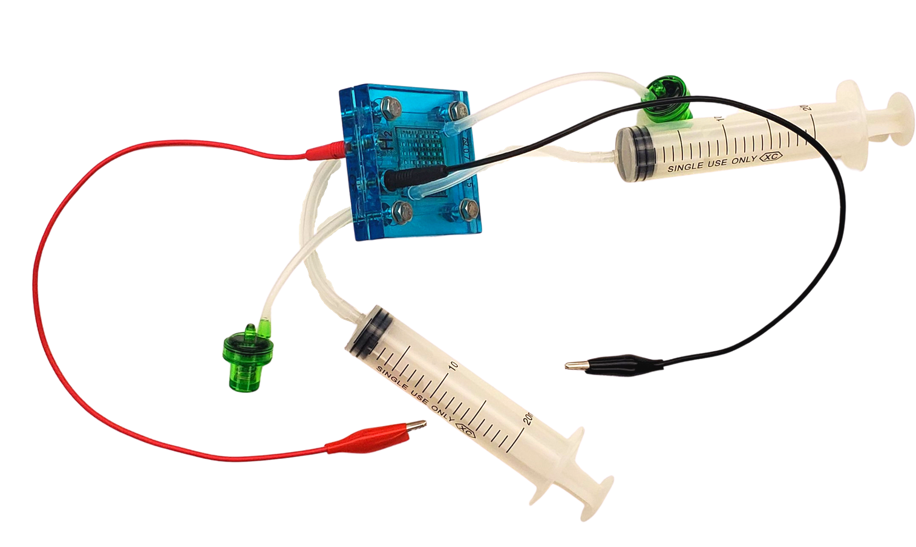
YOUR SETUP
SHOULD LOOK LIKE THIS AT THIS POINT

Slide 26
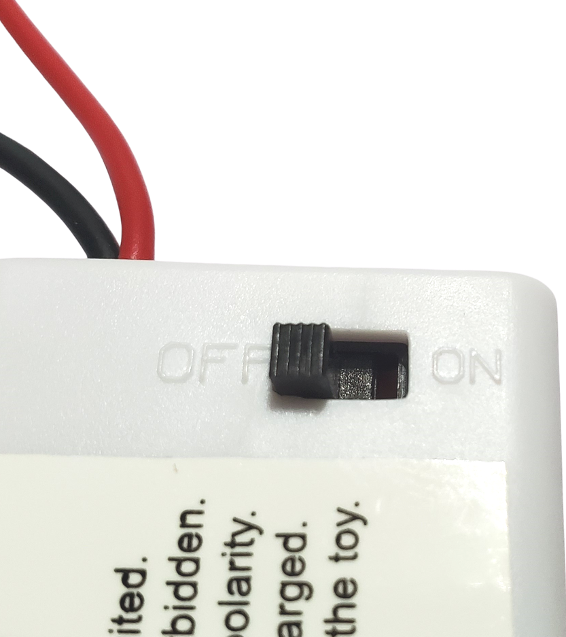
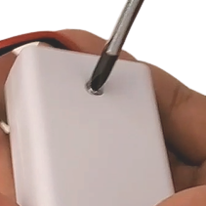
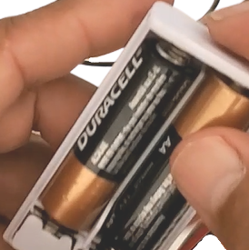
TURN OFF
REMOVE
THE SCREW THEN THE COVER
PLACE BATTERIES
Placing batteries in the battery box.

Slide 27
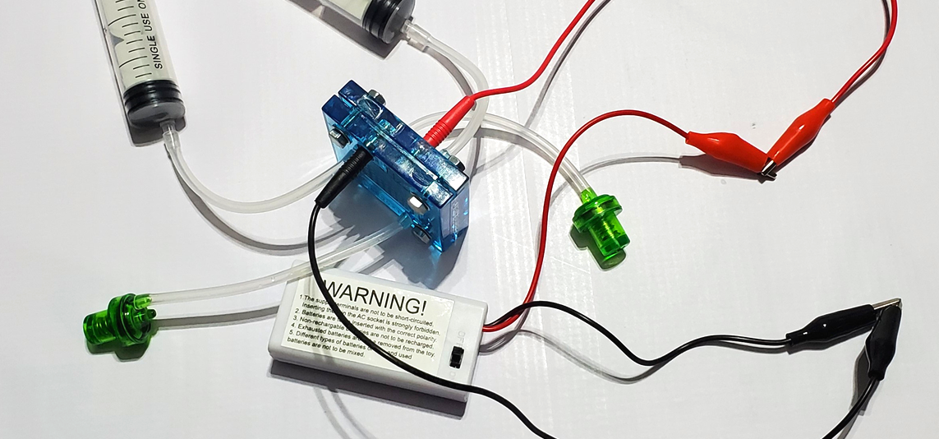
CONNECT THE ALLIGATOR CLIPS AS SHOWN
TURN ON

Slide 28
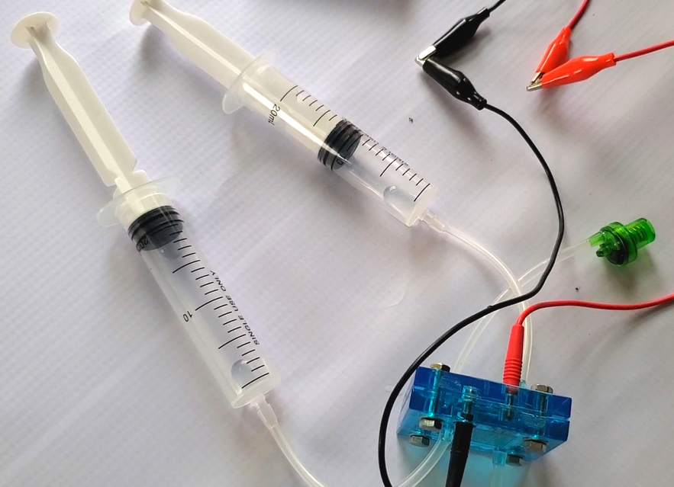
If the system works, you will see syringes fill up with gases.
When one of the syringes is filled to 20 ml, the experiment is done.
Turn the setup off.

Slide 29
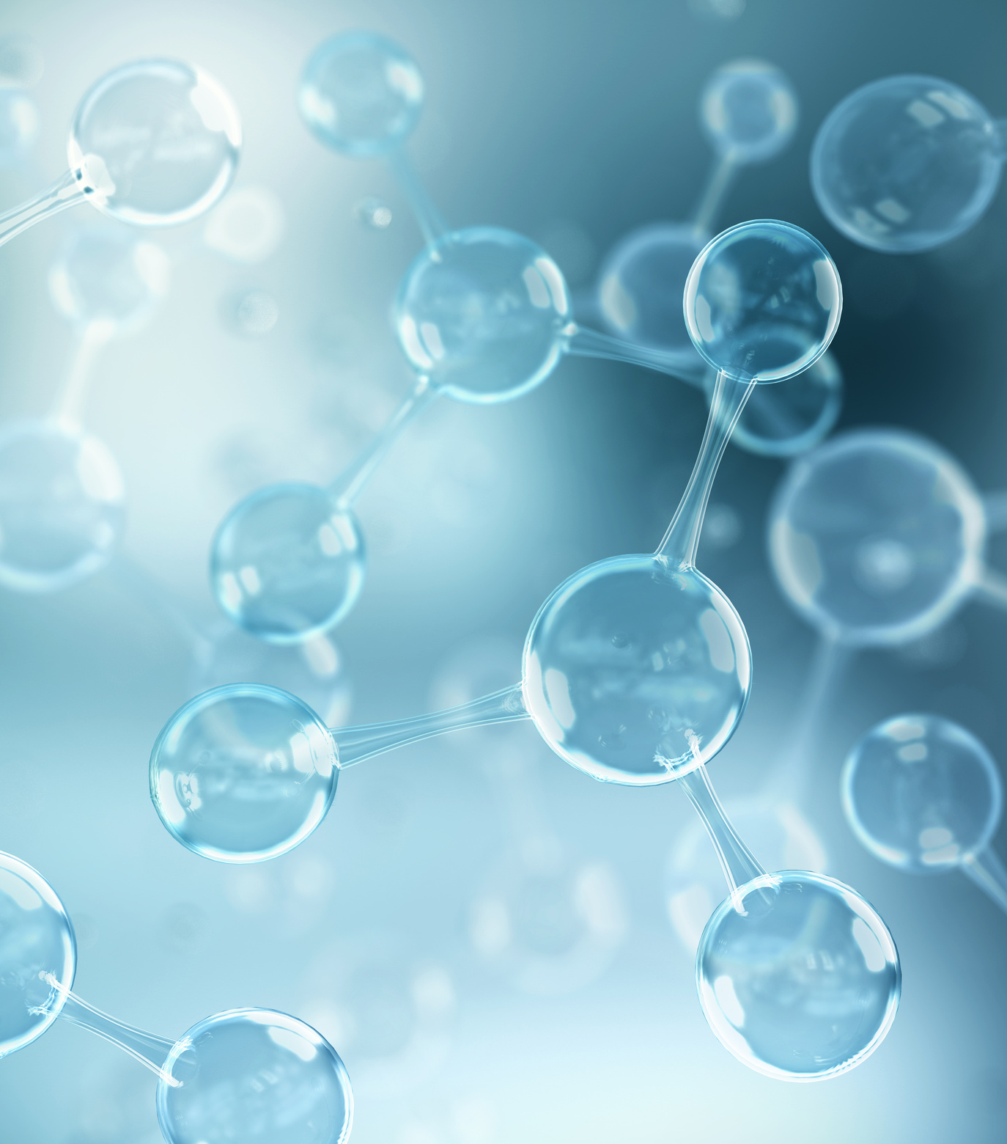
ANSWER
THE FOLLOWING QUESTIONS:

Slide 30
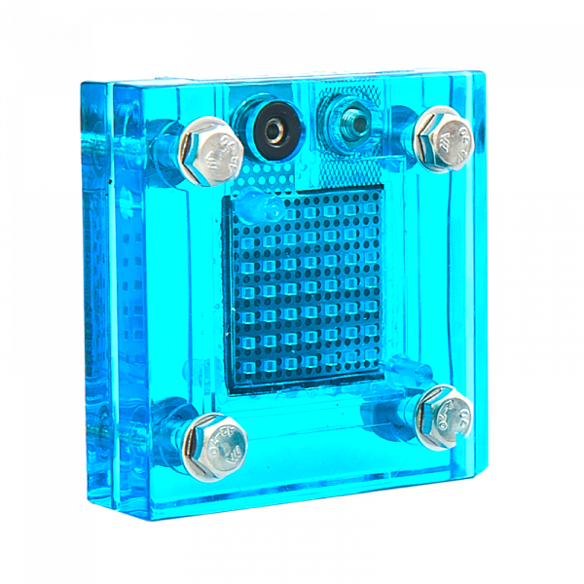
WHAT IS AN
ELECTROLYZER?
IT IS A DEVICE THAT USES ELECTRICITY TO SPLIT WATER INTO HYDROGEN AND OXYGEN.

Slide 31


WHICH OF THE
TWO SYRINGES MOVED FASTER TOWARDS 20 ML?
THE ONE ON THE HYDROGEN SIDE.

Slide 32

WHICH SIDE DID
THE HYDROGEN COME OUT OF?
POSITIVE

Slide 33
WHY?
BECAUSE HYDROGEN HAS A SLIGHTLY MORE
NEGATIVE CHARGE THAN OXYGEN.
WE KNOW THAT OPPOSITES ATTRACT.

Slide 34

H
H
WOULD YOU KNOW WHY OXYGEN WENT TO
THE OPPOSITE SIDE?
H
H
O
O
BECAUSE OXYGEN HAS A MORE POSITIVE CHARGE.

Slide 35
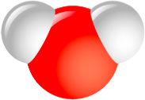
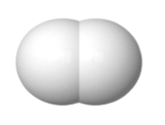
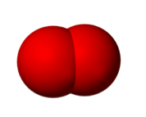
COMPARE THE AMOUNT OF HYDROGEN GENERATED
TO THE AMOUNT TO OXYGEN GENERATED.
Divide the hydrogen amount by two.
You should get the amount of oxygen.
Formula:
? mL of hydrogen
=
? mL of oxygen
2
Hydrogen to oxygen ratio:
20 mL of hydrogen
=
10 mL of oxygen
2

Slide 36
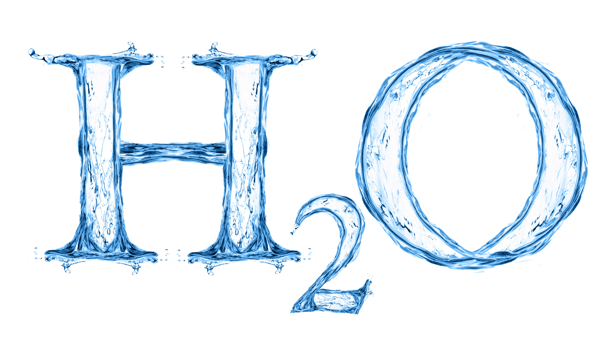
WHAT DOES THIS FORMULA
DEMONSTRATE?

Slide 37
WHAT DOES THIS FORMULA
DEMONSTRATE?
It demonstrates that there are 2 hydrogen atoms for every 1 oxygen atom.
This is where water gets the name ? .
Remember that we used pure distilled water.
That means the water is made up of only ? and ? .

Slide 38
WHAT DOES THIS FORMULA
DEMONSTRATE?
It demonstrates that there are 2 hydrogen atoms for every 1 oxygen atom.
This is where water gets the name H20 .
Remember that we used pure distilled water.
That means the water is made up out of only hydrogen and oxygen .

