Slide 1



CLEAN ENERGY
HYDROGEN
LESSON 3

Slide 2



EDUCATIONAL OBJECTIVES
Upon completion of this lesson students will be able to:
Demonstrate the ability
to use energy to break
chemical bonds
by using the DIY Kit;
Facilitate the generation
of electricity through
the process of chemical
reaction using the DIY kit;
Understand what
electrolysis is and how
it is used to split water;
Effectively assemble
the DIY chassis;
Analyze and interpret
the various applications
of hydrogen including
energy storage
and transportation.

Slide 3
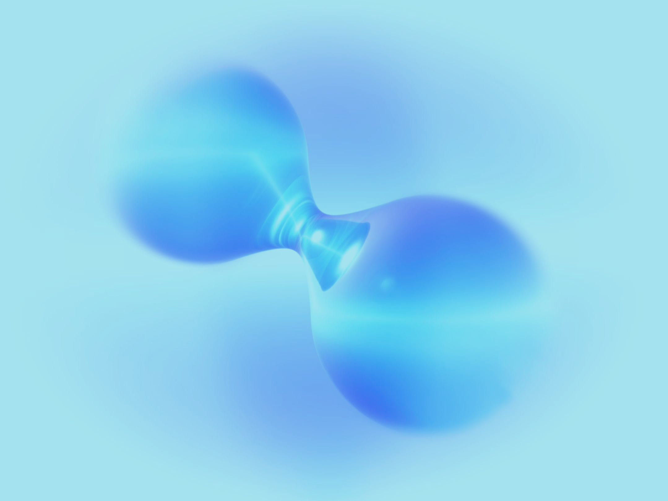









WHAT IS ELECTROLYSIS?
Electrolysis is a promising option for hydrogen production from renewable resources.
It is the process of using electricity to split water into it components: hydrogen and oxygen.
This reaction takes place in a unit called the electrolyzer - what you used in the previous lesson.
ELECTRIC CURRENT
e
-
FUEL IN
AIR IN
e
-
e
-
H
+
e
-
H
2
O
H
2
O
2
EXCESS
FUEL
H
+
UNUSED
GASES OUT
H
2
O
ANODE
CATHODE
ELECTROLYTE

Slide 4
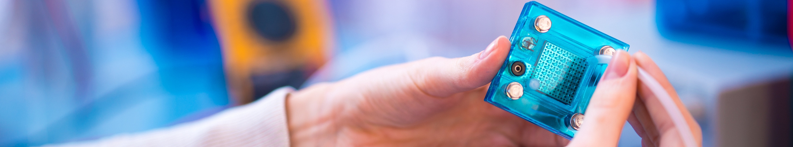
Now that you know what hydrogen is and how to produce it you can use this knowledge to produce electricity using the Fuel Cell!
The electrolyzer in your kit can now be used as a Fuel Cell by injecting the produced hydrogen and oxygen into it.
Follow the instructions provided in the DIY Chassis Assembly Presentation and/or watch the video for more specific instructions.

Slide 5
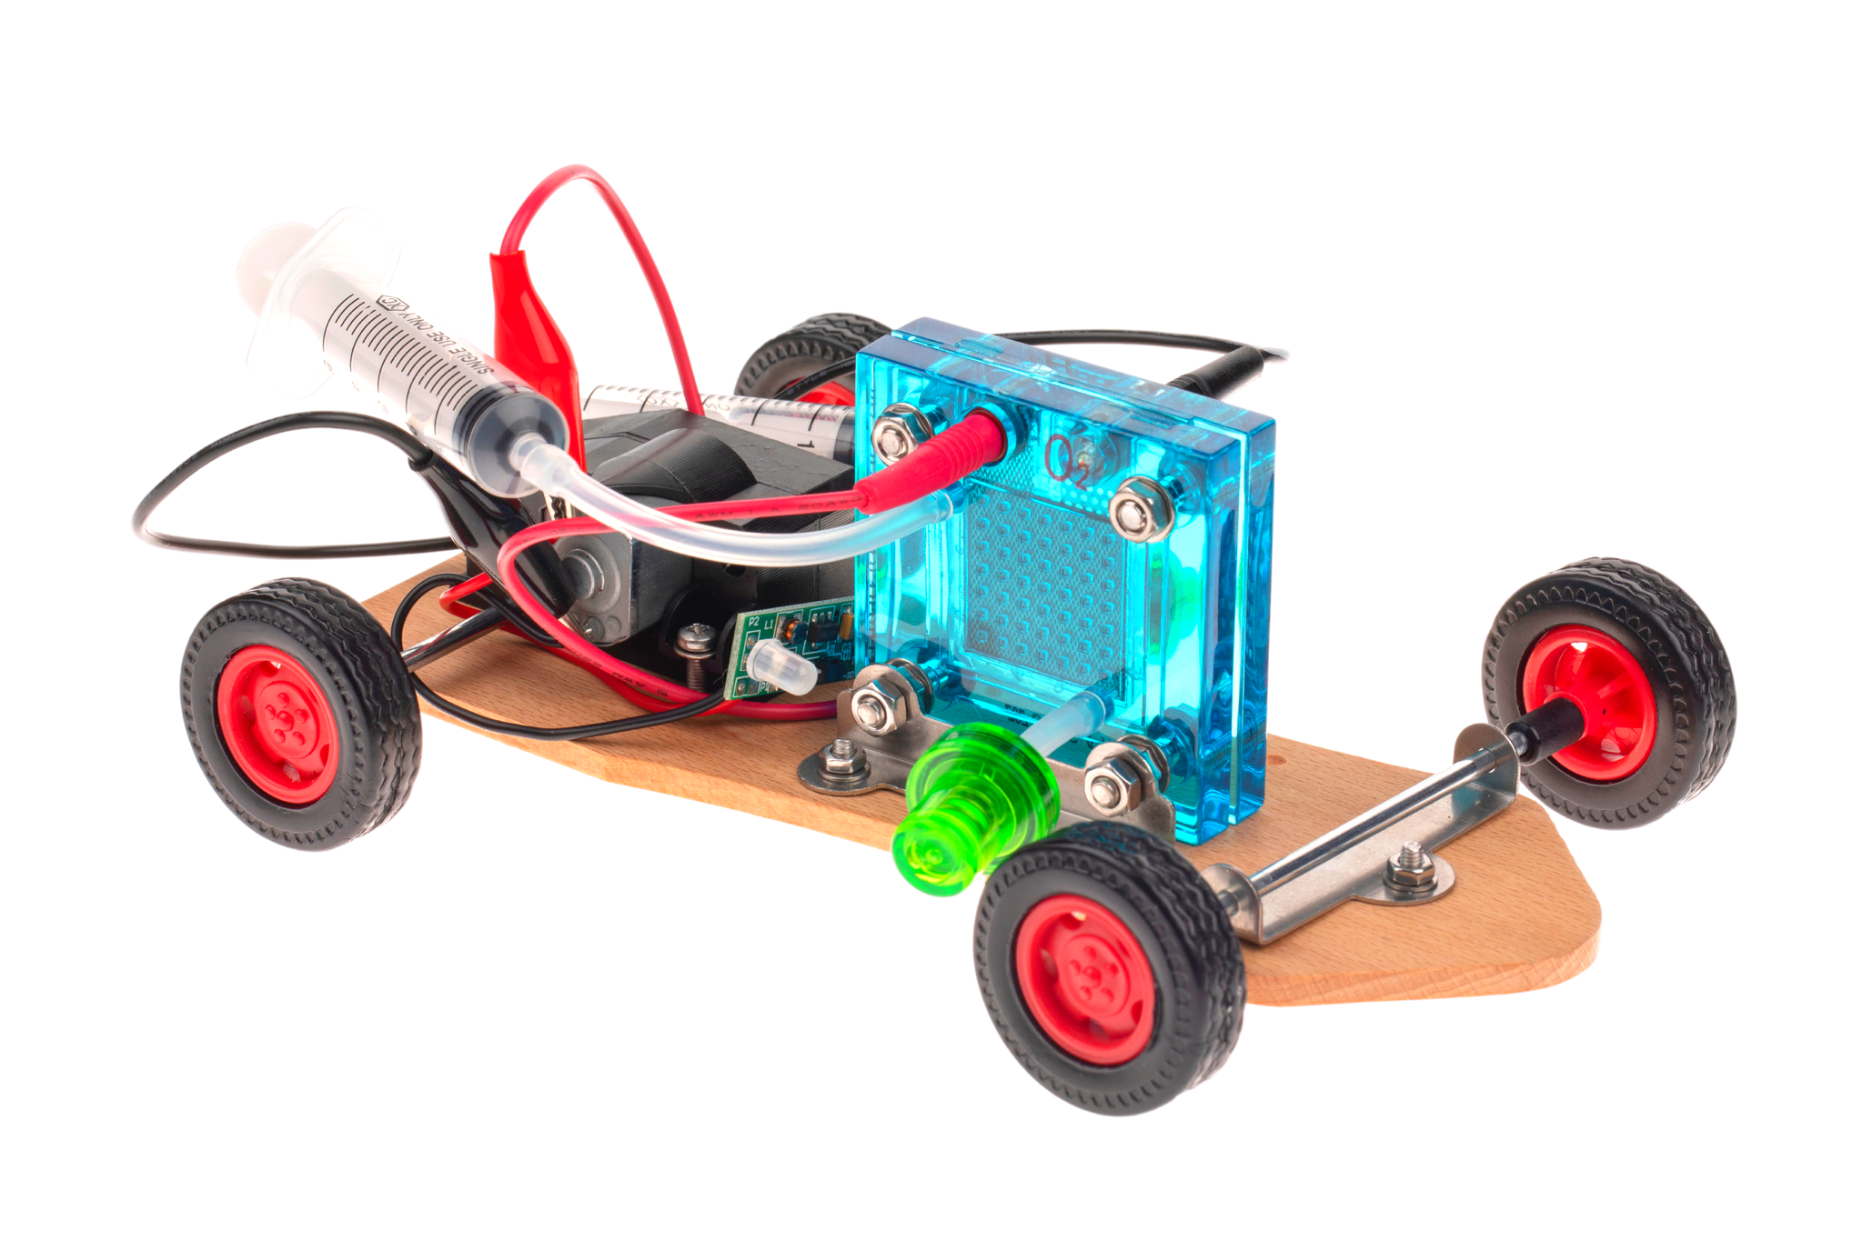
DIY CHASSIS ASSEMBLY

Slide 6





MOTOR AND TRANSMISSION
wheels
fuel cell holder
front wheel support
wooden chassis
metal profilled washer
axle

Slide 7
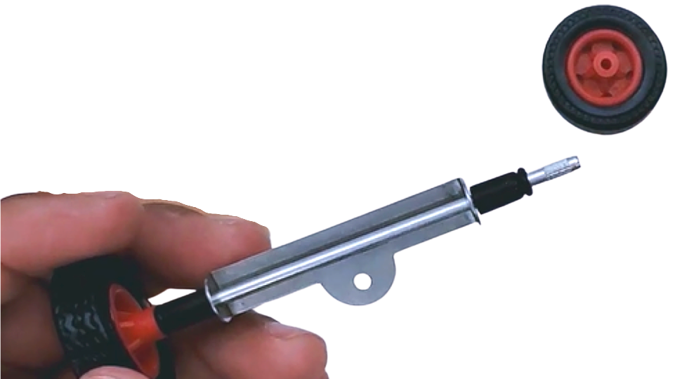

axle
rubber washer
front wheel
bumping post
front wheel support

Slide 8
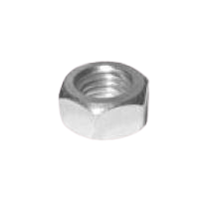



ATTACH TO CHASSIS
1st
2nd

Slide 9



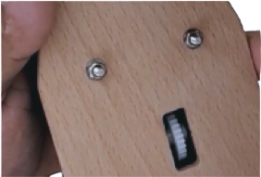
2. LONG SCREWS
1. CUTOUT ON LEFT SIDE
4. SMALL NUTS
3. METAL WASHERS

Slide 10
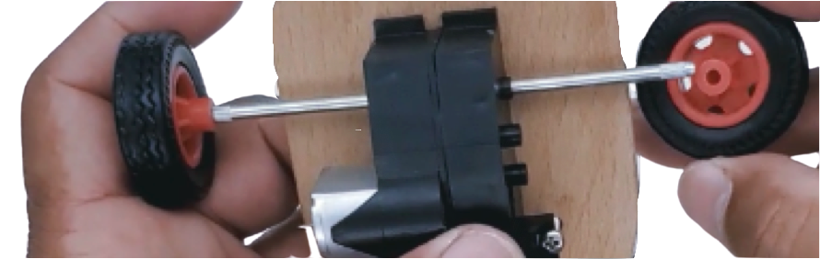
WHEELS

Slide 11
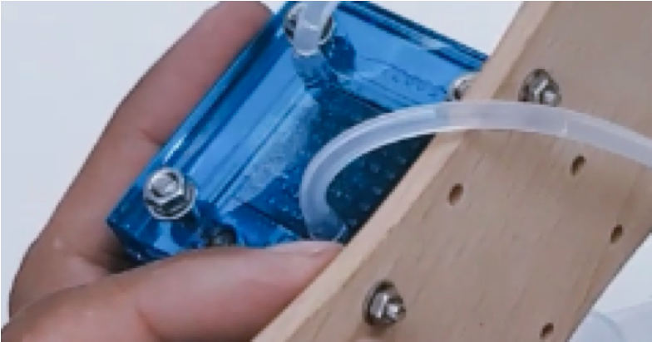

2. MOUNT TO CHASSIS
1. FUEL CELL HOLDER
FLASH METAL WASHER
SMALL SCREW
SMALL NUT
BIG NUTS

Slide 12
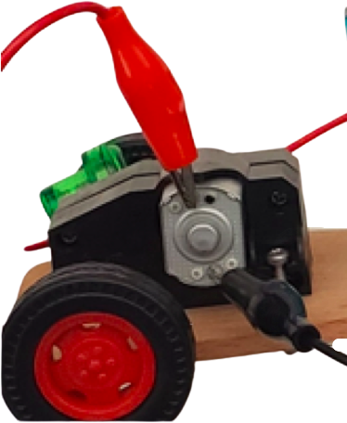

MOTOR CONNECTION
Note: If the motor runs backwards,
switch the cable connections.
Move the red to black position
and the black to red position.

Slide 13

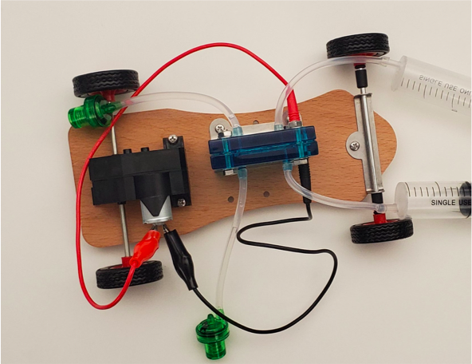
READY TO RACE?
Now that you have assembled all parts, run the car!
Make modifications and adjustments as needed.
Measure how far it can go with one hydrogen/oxygen charge.
Can you adjust the fuel cell input to make it run faster?

Slide 14

As a fuel cell to generate electricity.
As a source of heat and power for your home.
To refine petroleum and to produce fertilizers.
As a battery to store power for later use.
Transportation.
WHAT ARE SOME OTHER EXAMPLES
OF APPLICATIONS YOU CAN THINK
OF FOR USING HYDROGEN AS
A SOURCE
OF ENERGY?

Slide 15
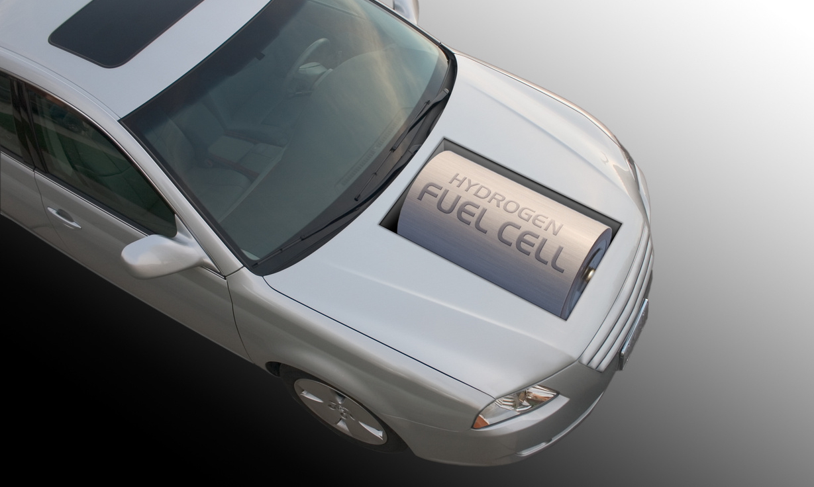
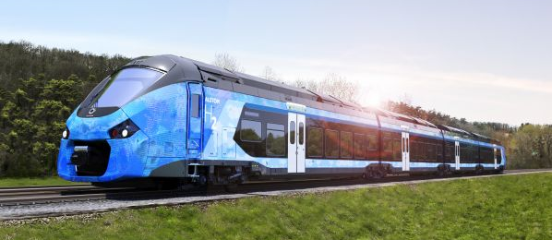

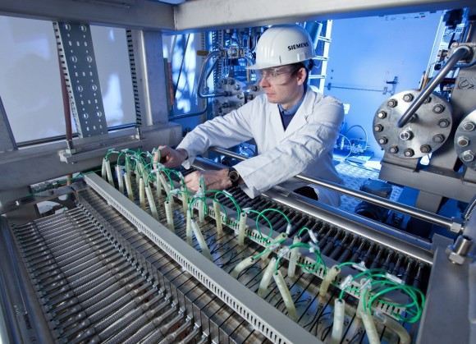

Slide 16
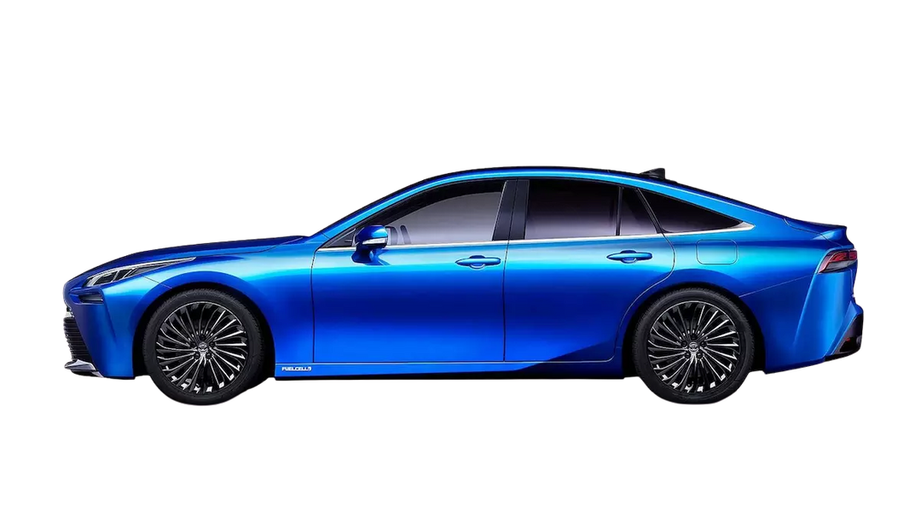
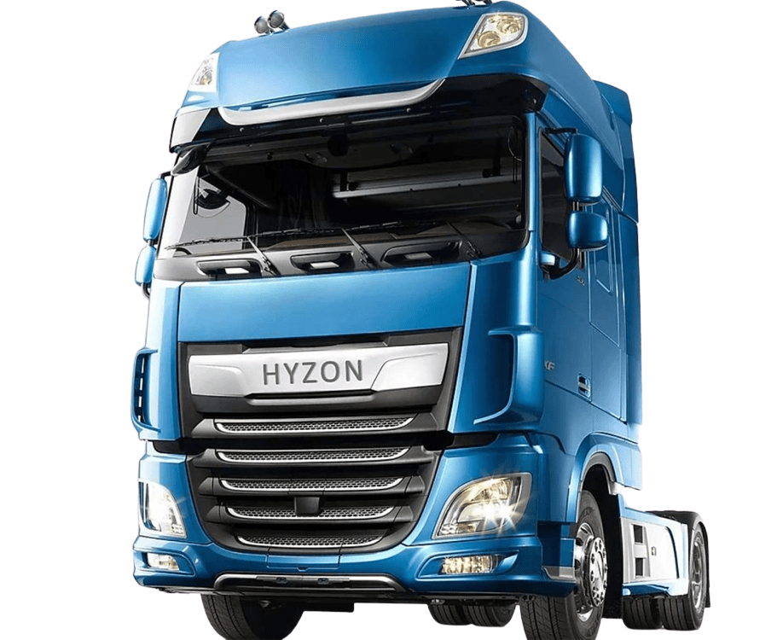
Hydrogen fuel cells are a RENEWABLE ENERGY and are being used in transportation
The Toyota Mirai can use about 4,8 kilograms of hydrogen as a source of fuel to produce electricity to run the electric motor in the car.
Trucks are also now being manufactured to use fuel cells slowly replacing fossil fuel-powered trucks, which means hydrogen brings us one step closer to having a cleaner environment!
ZERO EMISSIONS! THE EMISSIONS FROM ELECTROLYSIS
IS SIMPLY WATER, THE PRODUCT OF THE BOND
BETWEEN TWO PARTS HYDROGEN
AND ONE PART OXYGEN.

Slide 17


In fact, both elements are used in fuel cell technology but since oxygen is already present
in the air we breathe, fuel cells are capable of utilizing it.
Ar
CO
2
O
N
2
2
oxidizing
atmosphere
CH
H O
2
OCEAN
2
PLANTS
ANIMALS
Why is hydrogen used instead of oxygen to power fuel cell cars?

Slide 18

RESOURCES: UNITED STATES DEPARTMENT OF ENERGY, 101 VIDEOS
Energy 101 Geothermal: https://youtu.be/mCRDf7QxjDk
Energy 101 Wind Power: https://youtu.be/EYYHfMCw-FI
Energy 101 Solar PV: https://youtu.be/EYYHfMCw-FI
Energy 101 Biofuel: https://youtu.be/-ck3FYVNl6s

